Slide 1

Segmentation of Unruptured Intracranial Aneurysms from TOF-MRA Images Using Attention Based Deep Learning Techniques
ABHIK MAHATO
B.TECH (CSE), 4TH YEAR
ROLL NO : 18CS8020
UTKARSH AGARWAL
B.TECH (CSE), 4TH YEAR
ROLL NO : 18CS8151
UNDER THE SUPERVISION OF
Dr. DEBASHIS NANDI
PROFESSOR
COMPUTER SCIENCE AND ENGINEERING DEPARTMENT

Slide 2
Introduction
A brain aneurysm, also known as a subarachnoid hemorrhage (SAH), is a weak spot in the wall of a blood vessel inside the brain. The intracranial aneurysms are susceptible to get ruptured and can cause subarachnoid haemorrhage (SAH). The mortality rate of SAH is nearly 50%.
The risk associated with rupturing depends on the shape and size of the aneurysm. Larger the mass, greater the risk. Also irregular shaped aneurysms have a higher risk of rupturing.
So, early detection of intracranial aneurysms, as well as accurate measurement and assessment of shape, is important in clinical routine to allow informed treatment decisions.

Slide 3
Abstract
The purpose of this project is to build method of automatically detecting and segmenting unruptured intracranial aneurysms from Time of Flight Magnetic Resonance Angiographs (TOF-MRAs) using ResUnet++. This seeks to replace the existing practice of the histological study of biopsy reports which present the following problems:
It is very expensive and time-consuming
It is susceptible to human mistakes.
These drawbacks highlight the importance of implementing a completely automated deep learning-based technique, which this project seeks to address.

Slide 4
Proposed method
We first train a basic U-Net as a baseline model to check its performance on the given data. The results obtained on this model are unsatisfactory, hence we realize the need to train a deeper model for effective feature extraction. We then train ResUnet++ containing attention mechanisms and observe an improvement in results. The two models are discussed in detail in following slides.

Slide 5
U-Net
ResUnet++
The U-Net convolutional neural network architecture contains two paths. First path is the contraction path (also called as the encoder) which is used to capture the context in the image. The encoder is just a traditional stack of convolutional and max pooling layers. The second path is the symmetric expanding path (also called as the decoder) which is used to enable precise localization using transposed convolutions. Thus it is an end-to-end fully convolutional network (FCN), i.e. it only contains Convolutional layers and does not contain any Dense layer because of which it can accept image of any size. In the basic U-net architecture, the number of convolution layers in each resolution step is restricted to two, which may not be sufficient for effective feature extraction from the input image.
The ResUNet++ architecture is based on the Deep Residual U-Net (ResUNet), which is an architecture that uses the strength of deep residual learning and U-Net. The proposed ResUNet++ architecture takes advantage of the residual blocks, the squeeze and excitation block, ASPP, and the attention block.

Slide 6
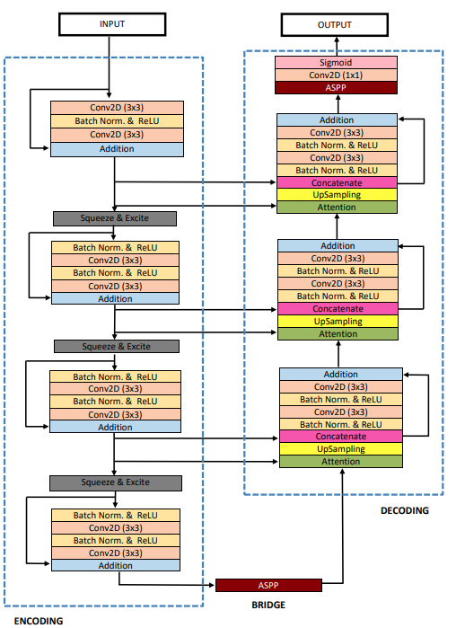
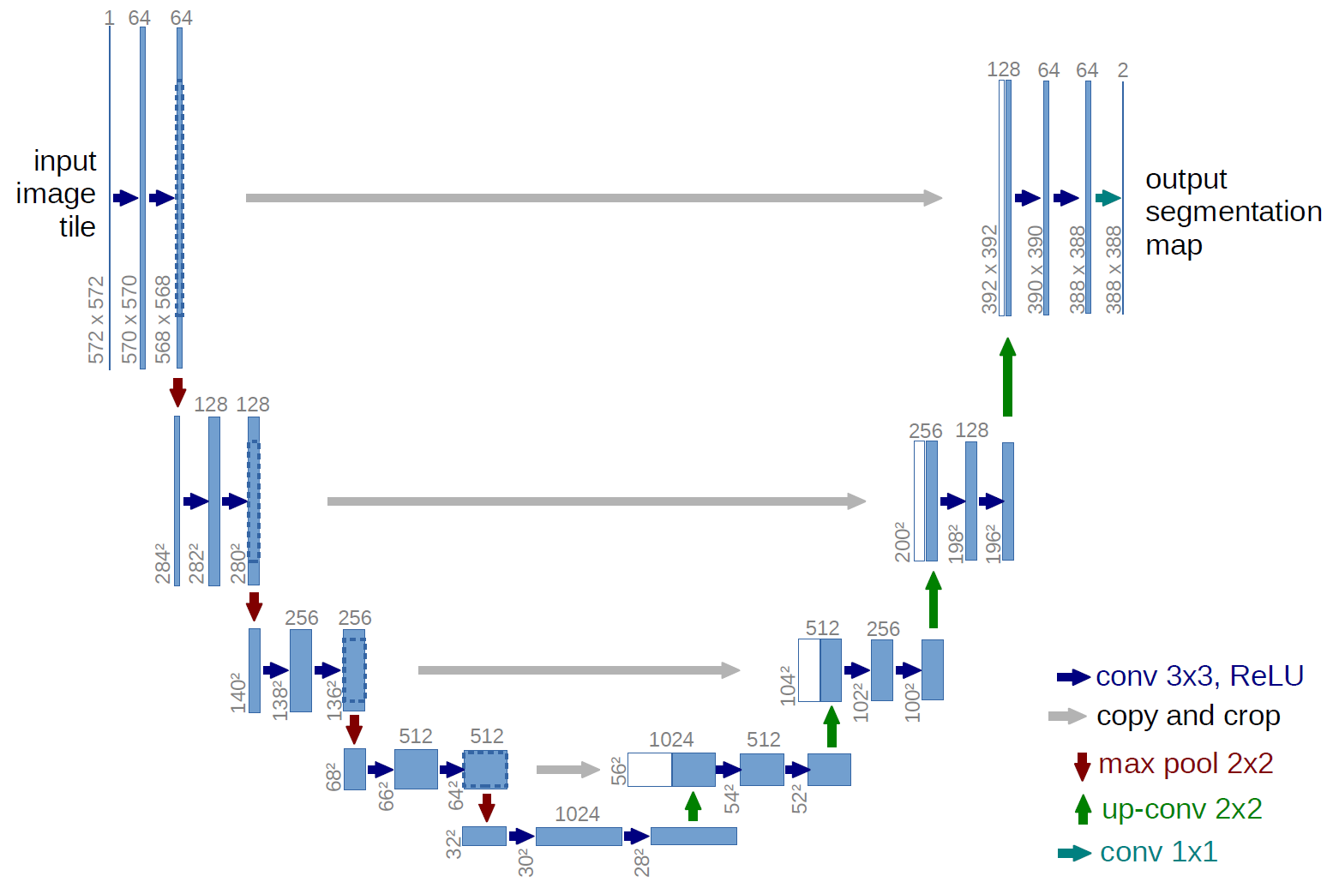
U-Net
ResUnet++

Slide 7
Data
Detailed description of the Data
For each patient the following data is provided -
Nii.gz file. Original TOF-MRA
Nii.gz file. Original structural image (T1, T2 or Flair)
Txt file. Transformation parameters used to align the structural image with the TOF image. Useful if using structural image for processing.
Json files. Scanning parameters for both TOF and structural data.
Nii.gz file. Structural image aligned with TOF MRA image.
Bias field corrected versions of all of the above imaging data.
Nii.gz file. Segmentation mask
Txt file. Location coordinates of center of mass of aneurysm.
Each case consists of one TOF-MRA and one structural MR image.
Trained dataset : 113 cases
93 cases containing at least one untreated, unruptured intracranial aneurysm
35 baseline and 35 follow-up of the same subject
23 unique subjects
20 scans of subjects without intracranial aneurysms

Slide 8
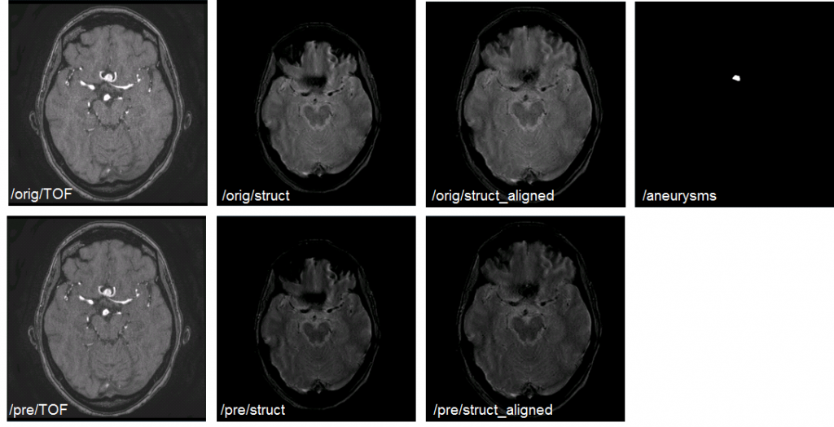

Slide 9
Data Preprocessing
A variety of preprocessing steps are used to make the data favourable for training the model.
N4 Bias field correction
The original TOF-MRA images are preprocessed using n4biasfieldcorrection to correct bias field inhomogeneities. The N4 bias field corrected images are provided with the original ADAM dataset.
Resampling
The original data was acquired from both 3T and 1.5T machines and contains data of various modalities(T1, T2 and flair). We perform resampling to convert this data obtained from different distributions to same voxel spacing (0.5mm x 0.5mm x 0.5mm). For resampling, linear interpolation is used for the original scan and nearest neighbor interpolation is used for the corresponding mask.
Intensity Clipping
Intensity clipping was performed using 0.5 and 99.5 percentile in order to remove outliers and the values which might hamper the efficacy of training the deep learning model.

Slide 10
Data Preprocessing (contd)
Normalization
Generally, MRI intensities are acquired in arbitrary units; thus, it becomes difficult to compare images across scanners, subjects, and visits, even if the same procedure is used. Intensity normalization brings the intensities to a standard scale across people. It affects the model’s performance, prediction, and inference. It is an essential step in any image analysis with more than one subject or time point to ensure comparability across images.
Patch Extraction
The size of the image volume is too large for the model to run without any memory issues. We extract samples in the form of (1x32x256x256)3D patches from the normalized data along with their corresponding mask. We extract 16 patches from each patient with 8 healthy samples (no foreground voxels) and 8 unhealthy patches containing aneurysms. We employ the dltk library in Python to efficiently implement patch extraction.

Slide 11
Training Model
TOF-MRA images are first pre-processed. The 3D patches obtained are used to train the model. ReLU activation function (ϕ(x) = max(0, x)) is utilized everywhere except the final output layer, where the Sigmoid activation is used. Both the models are trained for 20 epochs, using Focal Tversky loss as the loss function. Adam optimizer is used as the optimizing function with learning rates 0.0001 and 0.00001 for U-Net and ResUNet++ respectively.
After successfully training the U-Net model on 3D patches we check its performance on the test set. Testing is done patient wise using the sliding window approach to obtain 3D patches of the required dimensions.
The patch-wise output prediction masks are then reconstructed to obtain the original volume shape. Evaluation is then performed using this final volume as output prediction against the metrics.

Slide 12

Performance Metrics and Evaluation
We have used the Dice similarity coefficient (DSC), Sensitivity, and Specificity performance metrics
1. Dice similarity coefficient (DSC): It was used to check the performance of the reproducibility of manual segmentations and the overlap precision of automated probabilistic fractional segmentation of MR images, illustrated on two clinical examples.
Here, ˆy is the predicted result for the respective ground truth label y. The 0 ≤ DSC ≤ 1 measures the range of overlap between the ground truth and the segmentation results.

Slide 13


Performance Metrics and Evaluation (contd)
2. Sensitivity/Recall: Sensitivity (True positive rate or recall) measures the proportion of actual positives that are correctly identified.
3. Specificity : Specificity(True negative rate) measures the proportion of actual negatives that are correctly identified.

Slide 14
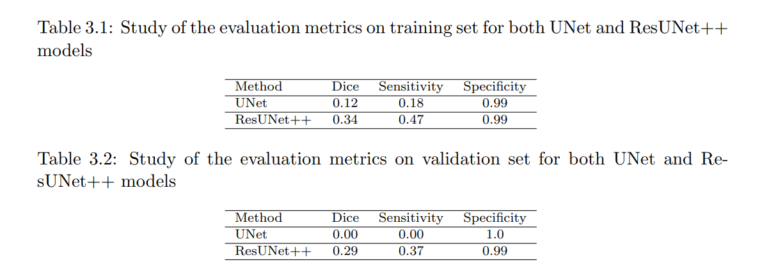
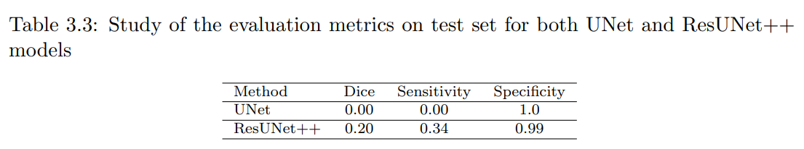
Results

Slide 15
Discussion
We observe that ResUNet++ outperforms UNet. Table 3.1 summarizes the performance of the models on the training set. UNet achieved 0.12 Dice, 0.18 Sensitivity, 0.99 Specificity, while ResUNet++ achieves 0.34 Dice, 0.18 Sensitivity, 0.99 Specificity.
ResUNet++ performs better than UNet in dice and sensitivity values. Specificity for both the models is 0.99 the reason for which could be the high level of imbalance in our data. Similar trends are observed in validation and test sets, the results of which are summarized in table 3.2 and table 3.3.
UNet fails to learn any distinguishing features and hence we obtain very low dice and sensitivity scores. ResUNet++ is more robust towards unseen data when compared to UNet, though the scores are still low. There is a lot of scope for improvement in results.

Slide 16
Conclusion
In this study, we train ResUNet++ , a neural network which uses residual skip connections and attention blocks to learn complex features. It improves upon the basic U-Net architecture which has limited feature extraction capabilities when compares to residual nets. We built a comprehensive training and testing pipeline to automate the task of detection of unruptured intracranial aneurysms which with some improvements and experience can help contribute towards building stronger and more robust radiology support systems.

Slide 17
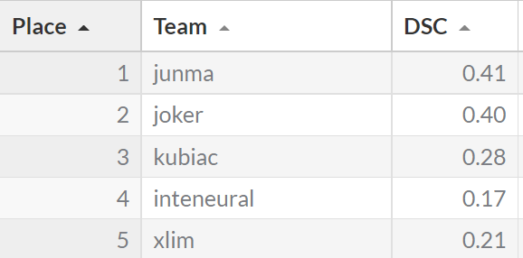
Other work Results

Slide 18
Future Works
We aim to further improve our performance since neither of the two models were able to perform at par with the top submissions of the challenge.
The data used in this study is highly imbalanced (Background vs Foreground: 8.3 × 10−6), due to which we faced difficulties in making the model learn the under-represented class.
Moving forward from CNNs, we plan to explore Transformer Networks. Transformers have gained popularity in recent years for imaging tasks since Vision Transformers adopted transformers which were initially mostly used for Natural Language Processing (NLP) tasks.
We will also learn about more image processing techniques which will help to make the data more favourable for training.

Slide 19
Thank You

